Slide 1

BIOF475
Introduction to New Technologies in Data Science
5-2-2018
Iago Pinal-Fernandez
Muscle Disease Unit

Slide 2
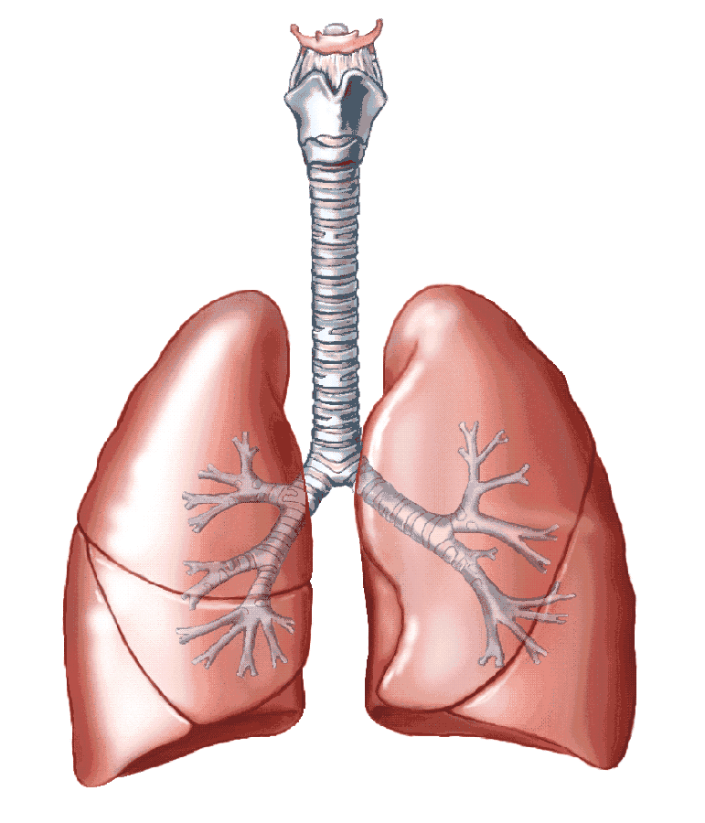
Myositis
Notes:
Myositis are a group of diseases that involve the muscle, lung, skin and joints.

Slide 3
Experimental design
20 NT, 126 IM, 13 SSc, 14 HSMM
RNA extraction with Trizol
Quantification with NanoDrop and PicoGreen
Quality control with TapeStation bioanalyzer
Library preparation with TruSeqTM Stranded mRNA Library Prep using the NeoPrepTM system
Sequencing using HiSeq2500 or HiSeq3000

Slide 4
Bioinformatic analysis
Demultiplex with bcl2fastq 2.17.1
Align with STAR 2.5
Quality control with FastQC 0.11.2
Quantification with Stringtie 1.3.3
Count conversion with PrepDE
Graphical analysis with RStudio and Shiny

Slide 5
Thank you

